Slide 1
Appendix A: How to Use Git
ECE 309
Dr. James Tuck

Slide 2
Objectives
Describe what git it is and why we use it.
Describe a simple workflow for using github.ncsu.edu.

Slide 3
Git
The purpose of Git is to manage a project, or a set of files, as they change over time.[2]
Git stores this information in a data structure called a repository. [2]

Slide 4
Contents of a git repository
The files you add to the repository
A collection of edits, called commits, that you make to the repository. Commits include:
Changing the content of a file (e.g. fixing code, updating a readme)
Adding new source code files
Removing source code files
Changing directory structure

Slide 5
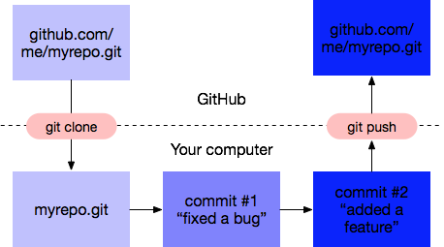
Basic strategy for git
Create your own new repository or fork one
Edit some files on your own computer
Compile and test them
Commit the changes
If you want to do more, go back to 2
When ready, push commits to GitHub to share with others

Slide 6
Git users think in terms of commits
A repo is a partially-ordered sequence of commits
We can view the history of the repo by looking through the commit history
Go to GitHub, pick a file, and look at the history of the file
If we make a bad commit that breaks our code, we can always revert to a previous good commit that works, but it’s better to avoid this through proper testing

Slide 7
Git Best Practices
Commit related changes together
Commit often, but don’t commit half done work
Test before you commit --- error-free compile is a bare minimum
Write good commit messages
See [3] for more info.

Slide 8
Multiple source files
It’s customary in C and C++ to divide programs into multiple files:
For faster compiles --- only need to recompile the files that were changed
Efficient development --- multiple coders working on different files
Better revision control --- the few files changed in a git commit reflect the purpose of the commit (more about this later)
Rule of thumb: put one or a few highly related classes together in a file

Slide 9
Split class declarations between header and source files
Class declarations go in header files so they can be shared by many source files
Member function definitions go in a single source file, because there should be only one definition of a variable or function

Slide 10
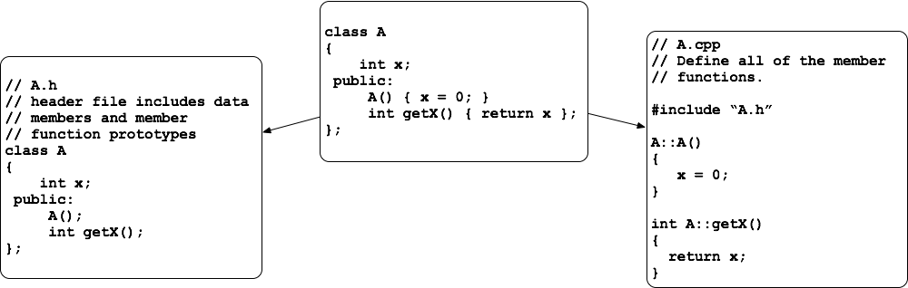
Split class declarations between header and source files
Note that member functions that only require a single line of code should be kept in the class declaration in the header file. I violated this stylistic rule to keep the example small.

Slide 11
A few things to note
The compiler must locate the header files that are included in order to build the code
The compiler automatically looks in several places:
System directories like /usr/include
The working directory
Directories used by the C/C++ standard library
If the include is placed somewhere else, we must tell the compiler where to look using the -I flag:
g++ -I /my/includes -o foo foo.cpp -Wall -Werror

Slide 12
Typical C++ git repository structure
toplevel-source-directory:
/include - include files for classes (e.g. A.h)
/lib - source files for classes (e.g. A.cpp)
/tests - programs to test our classes

Slide 13
Summary
Git is a valuable resource for tracking changes to code.
Commit often, but only commit code that compiles to a shared repository.
There are standard ways of organizing a repo unique to each programming language and you should follow them.

Slide 14
References
1. 2. https://www.sbf5.com/~cduan/technical/git/git-1.shtml
3. https://www.git-tower.com/learn/git/ebook/en/command-line/appendix/best-practices

